Slide 1
Writing Across the Curriculum Fifth Six Weeks
Read the articles on the links below. They both discuss the definition of “digital literacy”.
https://cleach.wordpress.com/what-is-digital-literacy/
http://digitalliteracy.us/
Use the graphic organizer to define digital literacy.
Write an “ACE It” response to the following question:
What is digital literacy? What does it look like?
Here are your sentence starters for your paragraph:
Digital literacy is characterized by…
In addition, …
Also, …
This is important because…
After you have completed the sentences above, copy and paste your paragraph into the Google form in the email with this file. You can also copy and paste the link below into your browser.
https://docs.google.com/forms/d/1DEXU_-DRFEwfdZ3BgynzHc6z6VmJQHcBsYBL1R2Pseg/viewform?usp=send_form

Slide 2
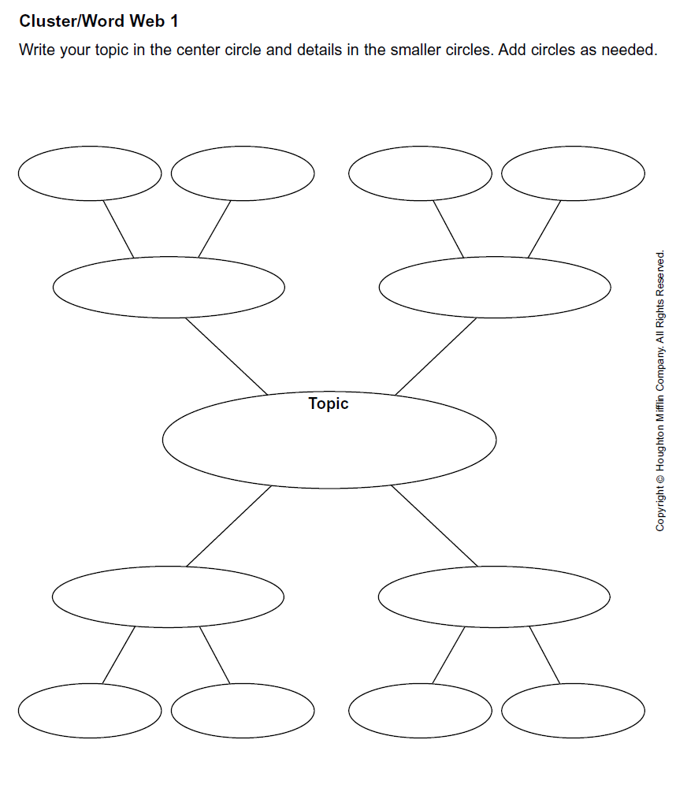
Digital Literacy

